Slide 1
Contra: A Programmable System for Performance-aware Routing
Kuo-Feng Hsu*, Ryan Beckett#, Ang Chen*, Jennifer Rexford⁺, Praveen Tammana⁺, David Walker⁺
Rice University*, Microsoft Research#, Princeton University⁺
Notes:
Thank you for the inducing, XXX. In this talk, I'll describe Contra. Contra is a system that can generate performance-aware routing protocols from high-level policies

Slide 2
Motivation: Performance-aware routing
G1: Traffic Engineering
e.g., prefer least utilized paths
"routing constraints" to "flexibility/generality", then it's not very clear
writing “topology + routing”? Then when explaining (e.g., Hula) we can mention that both topology and routing are fixed. And then in the next part the routing constraints would still make sense.
G2: Routing Constraints
G3: Fast Adaptation
e.g., middlebox traversal
e.g., update path choices upon performance changes
Notes:
Modern applications send a lot of data over the network. So efficient routing is very important.
Typically, we can think of three common goals
Performance and therefore we need traffic engineering. For example, …
Prefer certain route and therefore we have routing constraints. For example, …
Network condition changes very fast and therefore we need fast adaptation. For example, …

Slide 3
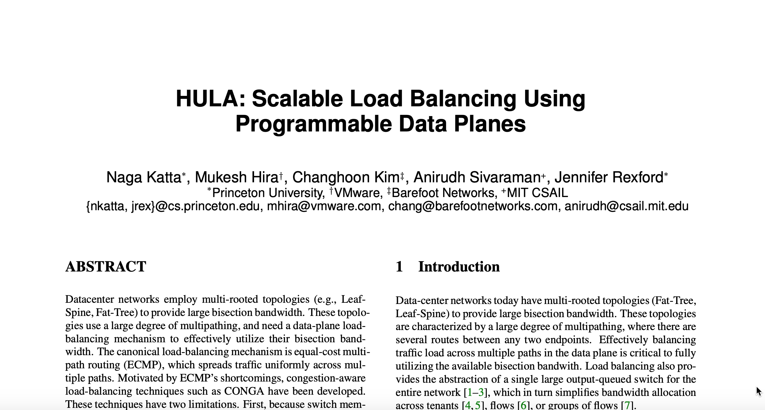
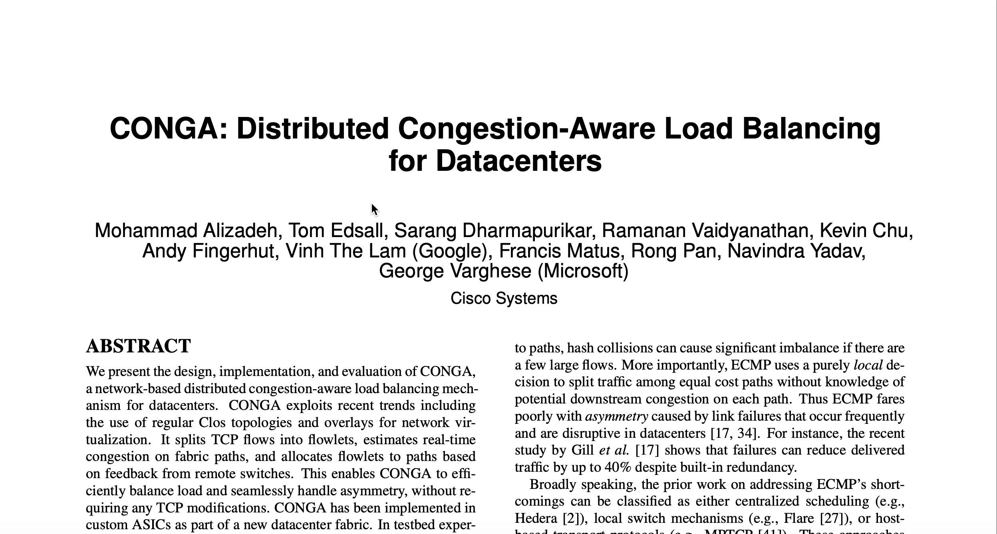
State of the art
G1: Traffic Engineering
G2: Routing Constraints
G3: Fast Adaptation
Some systems focus on G1 and G3
E.g., Hula (Katta-SOSR’16), Conga (Alizadeh-SIGCOMM'14)
Load balancing at RTT timescales (e.g., using P4)
Cannot support routing constraints; not applicable to arbitrary topologies

Slide 4
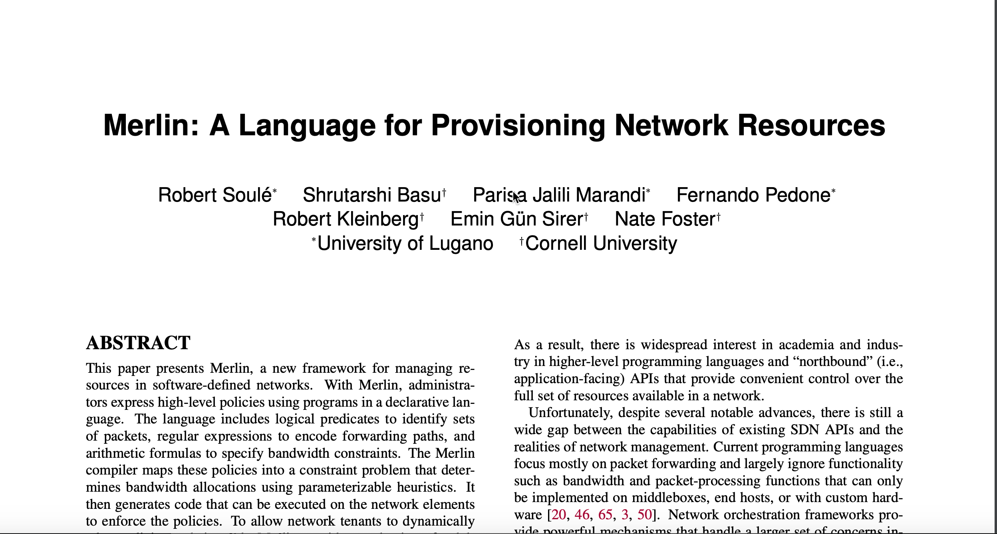
State of the art
G1: Traffic Engineering
G2: Routing Constraints
G3: Fast Adaptation
Other systems focus on G1 and G2
E.g., Merlin (Soulé-CoNEXT'14)
Support path constraints (in the form of regular expressions)
Control plane solutions; adapt slowly

Slide 5

Key question: One system for all three goals?
Notes:
Considering a network between sender and receiver.
We may want to avoid path with congestion by finding another path

Slide 6

Key question: One system for all three goals?
Avoiding paths with low performance
Notes:
in the meantime, we also want to make sure the traffic to go through a firewall.

Slide 7

Key question: One system for all three goals?
Avoiding paths with low performance
Satisfying routing constraints
Notes:
Also, when paths with higher performance become available, we may also want to change the paths

Slide 8
Key question: One system for all three goals?
Avoiding paths with low performance
Satisfying routing constraints
Adapting to changes quickly
Challenging … but Contra achieves all these!
Notes:
(Don’t say complicated) As you can see, achieving all the above is quite challenging

Slide 9


Contra at 10,000 feet
Policy
Switch programs
Topology
Contra
Language + Compiler: Compiles rich, high-level policies
Runtime: Performance-aware routing protocols that run in the data plane
Notes:
Now, let me give you an overview of Contra.

Slide 10
Outline
Motivation: Performance-aware routing
Existing work
Contra overview
Our system
Policy language
Compilation
Distance vector protocol
Evaluation
Conclusion
Notes:
So far, I have told you about the motivation for performance-aware routing, Next, I will describe how Contra works in the rest of this talk.

Slide 11
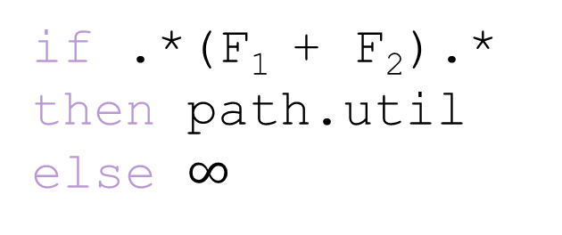
Example policy: Waypointing + load balancing
F₁
Path Constraints
S
X
D
if .*(F₁ + F₂).*
then path.util
else $∞$
Metrics
F₂
The Contra language has two components
Path constraints using regular expressions (e.g., .*(F₁ + F₂).*)
Performance metrics (e.g., path utilization)
Notes:
To see a concrete policy example Contra can support, consider this network topology where we want to have waypointing and load balancing.
By way pointing, we want to forward traffic through either F1 or F2 but not X.
In the meantime, we also want to balance the traffic between the feasible paths.

Slide 12
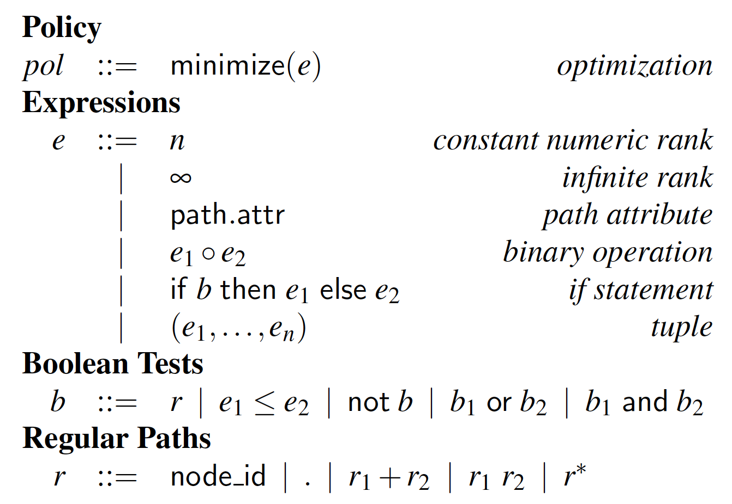
Contra language syntax
A policy maps paths to ranks based on their performance
Notes:
This is the syntax of Contra; the details are not important. But a policy is just a function that maps paths to rankings based on their metrics.

Slide 13

Contra can support many policies
S
D
S
D
X
Shortest Path: path.len
Widest Shortest Path: (path.len, path.util)
S
D
D
Y
Source-local preference:
if X.* then path.util else path.len
Least Utilized: path.util
More examples and detailed discussions in our paper
Notes:
With this language, contra can support many useful policies.
For examples, user can simply write down a single metric like path DOT len to implement shortest path, and path DOT util to implement least utilized path.
Users can also write path.len comma path.util to implement a widest shortest path policy which prefers shortest paths first, and among all shortest paths, it picks the least utilized one.
Even more with regular expressions, users can even specify different metrics for different types of paths.

Slide 14
How can we compile the policies to switch programs?
Probe
Data
Automata
Topology
Intermediate Representation
Routing Protocols
Policy analysis
1. Convert regular expressions in the polices to automata
2. Merge automata with topology into an intermediate representation (IR)
Routing protocol
3. Define routing protocols based on the IR
4. Synthesize P4 programs which track policy states

Slide 15
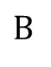
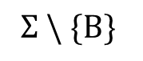
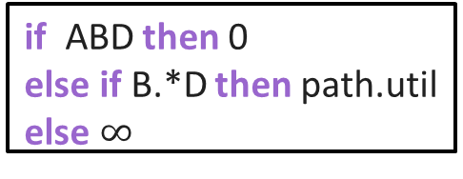
Policy analysis
$$Σ \backslash \{B\}$$
if ABD then 0
else if B.*D then path.util
else $∞$
0
D
1
B
2
A
3
0
D
1
$$B$$
2
The automata
The routing policy
D0
A
C0
B1
B
C
A0
D
B0
A1
The network topology
Product graph (PG)
Product graph = automata + topology (Merlin)
Every PG path is a policy-compliant path in the topology
Notes:
Abstract policy with graph data structure

Slide 16
Defining routing protocols on the PG
Probe
D0
Data
C0
B1
At node B0
A0
Dst | bestNxt | Metric
D0 | C0 | 0.8
B0
A1
Product graph (PG)
Goal: Discovering the best paths at runtime
Destinations send probes, which carry performance metrics
Nodes update forwarding decisions to choose the best paths
Basically, Contra generates distance vector protocols on the PG
Notes:
Because of this property (previous slide), we can now define a routing protocol without violating the path constraint.
To discover the best paths, first, nodes send probes to each other.
during the probe propagation, switches keep tables to always remember the best next hop to a destination and the performance metrics.
Across switches, these tables will form best paths to each for a given destination
(Don’t say Normal)

Slide 17
Tracking policy states in data plane
D0
At switch B
At node B0
B1
A
Current
B0
Dst | bestNxt | Metric
D0 | C0 | 0.8
C0
B1
B
C
A0
B1
D0 | D0 | 0.7
B0
A1
D
D0
The product graph
Routing
Goal: Ensuring the discovered paths are policy-compliant
Switches encode the PG into tables
PG states are tagged to packet headers
Switches update PG tags as they forward packets
Notes:
To ensure the switch implementation follows the product graph and therefore ensure the discovered paths are policy-compliant
We encode the PG into tables on switches.
Since one switch can correspond to multiple PG nodes, we combine their forwarding tables into one.
We need to tag the packets with correct PG states in order to track the state transition.
For example, a path on PG corresponds to a path on network topology.
When packets from node A with tag B1 arrive switch B, switch B can update the tag correctly based on the table.

Slide 18
Let's see an example!
A
B
0.1
0.1
0.1
0.2
Probe
S
D
Data
A simple policy (i.e., least-utilized) over a tree-like topology
All paths are policy-compliant, i.e., no path constraints
Contra would generate a "Hula-like" policy
Notes:
Let’s take a look at a simple example, where we use least utilized policy over a structured topology.
Actually, in this particular scenario, Contra would generate the protocols that are very similar to an existing work called Hula, which I briefly mentioned before. There are some important differences, of course: Hula is specialized only for this policy and topology, but Contra can be programmed to target a wide range of scenarios.

Slide 19

Handling changing metrics: Loops
Probe
Data
1
A
Time = 1
1
Time = 1.5
B
C
D
1
A
2
B
C
A
2
D
B
C
D
Time = 2
2
Problem 1: Transient loops
→ Use sequence numbers in probes (DSDV, Perkins-SIGCOMM ‘94)
Notes:
ONE REASON FOR THIS (as there are many reasons that may cause loops) is because probes take time to propagate. So the views of different switches may not be synced in transient states.
this is a common problem with DV protocols *ON GENERAL TOPOLOGIES!* Notice that Hula is specialized for structured topology so it doesn’t have this problem.
So we borrow idea from …
Seq to distinguish probes from diff round
So that we can mitigate transient loops
note that since the network is still async, this does not provide hard guarantees that it eliminates loops; but empirically, this mitigates transient loops very effectively

Slide 20
Handling changing metrics: Out-of-order delivery
1
FlowID | next
2
3
Flowlet switching table
…
4
3
2
1
…
1
3
2
4
4
…
4
3
2
1
Problem 2: Out-of-order delivery
→ Group packets in the same flow into flowlets (FLARE, Sinha-HotNets'04; HULA)
Notes:
Changing metrics can raise problems, and we borrow ideas from existing works to solve them
Idea from wireless network routing
Flowlet solves the oscillation problem

Slide 21
Handling change metrics: Policy violation by flowlets
Time = 1
C
F
PG state
FlowID | next
S
E
D
A
B
Flowlet switching table
Time = 2
Problem 3: Flowlet switching might cause policy violations!
Root cause: Asynchronous expiration of flowlet entries
E.g., Source picks a different route for new flowlet
But the middle switch may still pin the flowlet to the upper path
→ Policy-aware flowlet switching (extending flowlet switching tables with PG states)
Notes:
traditional flowlet switching can cause policy violation.

Slide 22
Contra handles many other challenges
Challenge | Key idea
Reducing transient loops | Sequence numbers
Out-of-order delivery | Policy-aware flowlets
Mitigating view inconsistency | Limited probe frequency
Detecting failures | Routing entry expiration
Multiple metrics | Policy decomposition
Breaking transient loops | Data plane loop detection
Detailed discussions on challenges in our paper

Slide 23
Outline
Motivation: Performance-aware routing
Existing work
Contra overview
Our system
Policy language
Compilation
Distance vector protocol
Evaluation
Conclusion

Slide 24


Evaluation setup
Compiler prototype
7485 LoC, in F#
Compiles to bmv2
Experimental environments
NS3 simulation (w/ bmv2 support)
Mininet emulation (CloudLab)
Several types of topologies:
Fattrees, and arbitrary topologies (e.g., Abilene)
Workloads:
Web search (Alizadeh-SIGCOMM’15), Cache (Roy-SIGCOMM’15)
Fattree
Abilene

Slide 25
How scalable is the Contra compiler?
4
Lower is better
P3
P2
P1
2
Compilation time (s)
0
20
125
245
405
500
Fattree size (# of switches)
The compilation finishes in a few seconds!
Policy P1: contains a single metric
Policy P2: contains multiple metrics
Policy P3: contains regular expressions
Runs before the deployment, not in “critical path”
Notes:
on fattree topologies OF DIFFERENT SIZES
Compilation is done before runtime.

Slide 26
How competitive is Contra against hand-crafted solutions?
Symmetric Fattree
Asymmetric Fattree (with failure)
100
300
Average FCT (ms)
ECMP
Lower is better
Average FCT (ms)
ECMP
Hula
Hula
Contra
200
Contra
50
100
0
0
20
40
60
80
100
20
40
60
80
100
Network load (%)
Network load (%)
Performance metric: Flow completion time
Baseline 1 (ECMP): Performance-oblivious static load balancing
Baseline 2 (Hula): Hardcodes a "least-utilized" policy
Contra: Implements a Hula-like policy
Notes:
Summarize key findings in terms of Contra/Hula vs. ECMP in FCT.
Both Contra and Hula are performance-aware routing so they can outperform ECMP by avoiding congestion and therefore shortening the flow competition time. And the benefits are particularly significant when the network load is high

Slide 27
How about arbitrary topologies?
250
Lower is better
Average FCT (ms)
Shortest paths
SPAIN
150
Contra
50
20
40
60
80
100
Network load (%)
Note: ECMP and Hula only work for structured network topologies
Baseline 1 (Shortest paths): Without load balancing
Baseline 2 (SPAIN): Static load balancing over multiple paths (Mudigonda-NSDI’10)
Contra: Implements a “least-utilized” policy for this topology

Slide 28
How often do we see transient loops?
Loop: 0.02%
Non-shortest:
16.6%
Shortest: 83.4%
Policy: Least utilized paths. Topology: Fattree
% of packets that traverse shortest vs. non-shortest paths vs. loops
Contra picks non-shortest paths when they have lower congestion
Transient loops do exist, but they are rare!
Notes:
Another important question is how effective can Contra mitigate the loops.
We use least utilized paths policy on a fattree.
And count the number of packets experiencing loops and longer paths and shortest paths.
We found that most packets are using shortest path.
But, some packets use non-shortest path, because the policy itself prefer these paths when they have lower congestion.
Finally, the transient loops do exist, bt they are rare. This shows that Contra can mitigate loops effectively.
Notice that the loops are transient so no packets are caught permanently in a loop.

Slide 29
See more evaluation results in our paper
How scalable is the Contra compiler?
How competitive is Contra in its performance?
How often and severe are transient loops and longer paths?
How much memory overhead does Contra incur?
How much communication overhead does contra incur?
How well does Contra balance load?
How fast can Contra react to failures?

Slide 30

Conclusion
Motivation: Performance-aware routing
Our system: Contra
Programmable: Sophisticated policies
General: Arbitrary topologies
Responsive: RTT-timescale adaptations
Evaluation:
Competitive with hand-crafted solutions
Supports many useful policies
Runs entirely in the data plane
Notes:
I introduced the three goals of performance-aware routing
The existing works cannot be easily extended to support all of them.
So we proposed Contra,
It can support many policies on arbitrary topologies
Evaluation shows that Contra is scalable and is competitive with hand-crafted solution.
Thank you for your ATTENTION. I am happy to take any question.

Slide 31
Backup

Slide 32
How often do we see transient loops?
1
0.8
Left is better
0.6
CDF
Hula/Contra (WSP)
0.4
Contra (MU: shortest)
Contra (MU: non-shortest)
0.2
Contra (MU: loops)
ECMP
0
0
0.3
0.6
0.9
1.2
1.5
In-network time (ms)
MU: limited number of loops
WSP: static metric (path length) avoids loops
Even packets with loops in MU experience shorter latency than ECMP
Notes:
but of course, this is allowed; these paths have lower congestion level. so using these paths can improve performance.
very few! so Contra mitigates transient loops effectively.

